Slide 1




Writing About Science
Penny Duran
Mentored by Daniel Stolte
Arizona Space Grant Statewide Student Research Symposium
April 19, 2025

Slide 2

Purpose of science writing
Scientific papers, expert audience
Challenge of communicating science to “laypeople”
Science writers = translators
Press releases communicate research conducted at University of Arizona

Slide 3

Press Release Vs. science news story
Press releases written and published by institutions, promoting research
Science news stories written by other media outlets
News outlets often pick up news in press releases and produce their own stories
Challenging to make distinction

Slide 4

“recipe” for a press release
Step 1: Background reading
Step 2: Interview
Step 3: Condense information in transcript
Step 4: Produce initial draft
Step 5: Editing with mentor
Step 6: Researchers review draft
Step 7: News release distribution platform

Slide 5
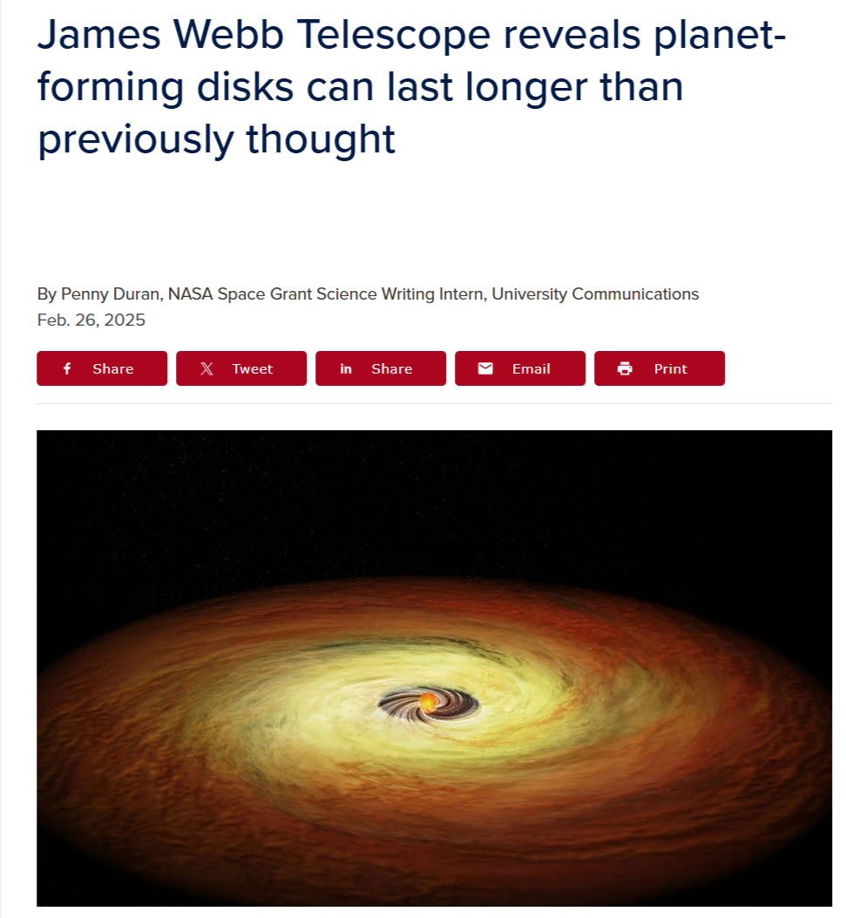
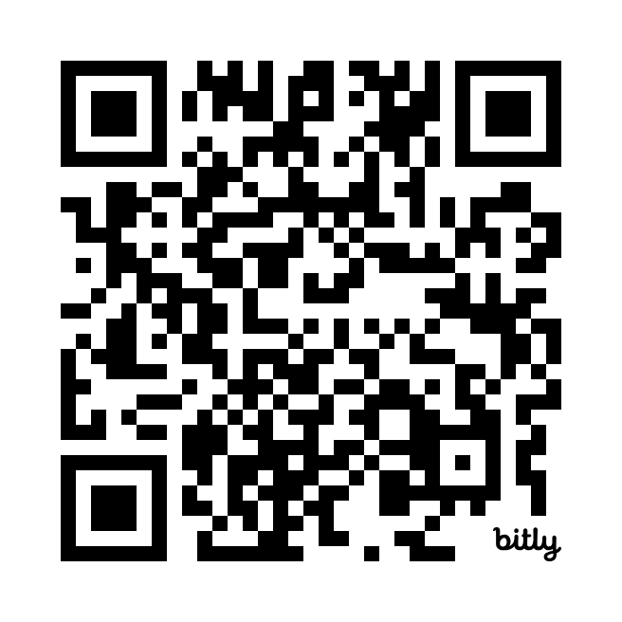
How planets are born what is news?
Initially challenging to find the news
How research relevant in “big picture” not clear from paper
Interview revealed what makes research engaging
“baby pictures” of solar systems, planet formation
Read story here:

Slide 6
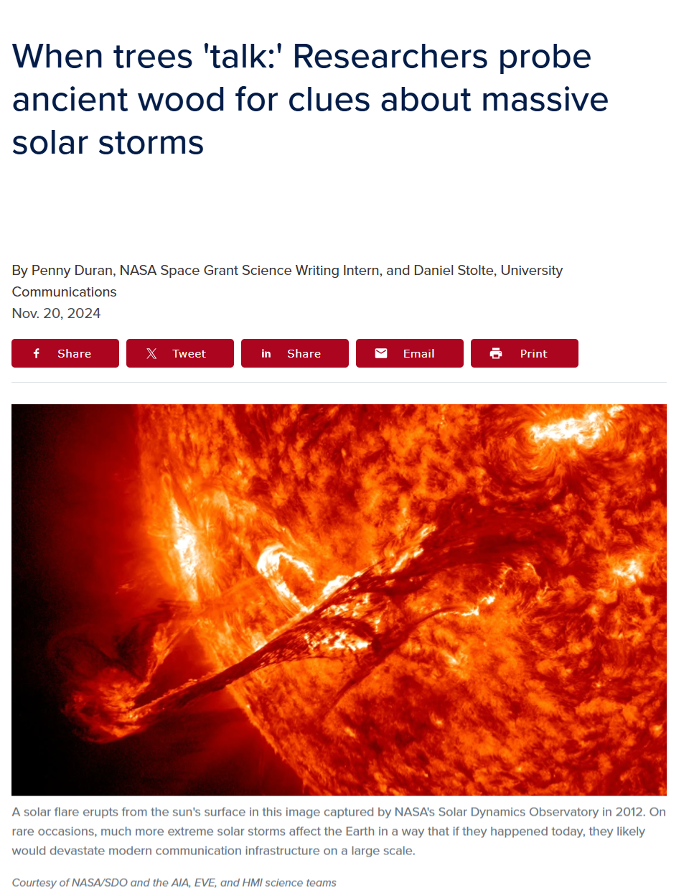
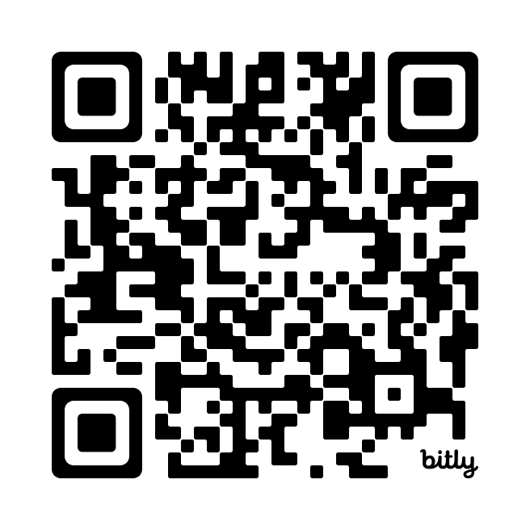
When the sun erupts the challenge of “translation”
Researcher with very technical approach
Difficult to “translate” and break down information
Needed to read more preexisting science stories to grasp material
Main takeaway of research not what I expected
Read story here:

Slide 7
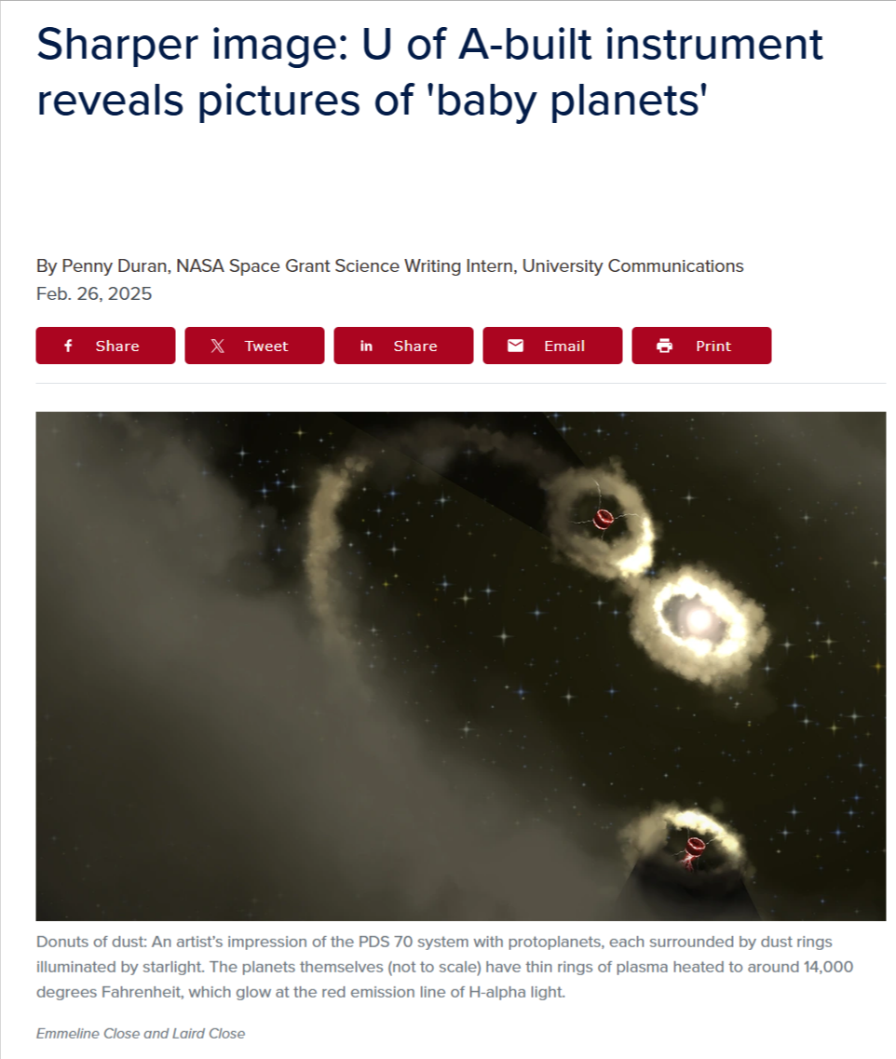
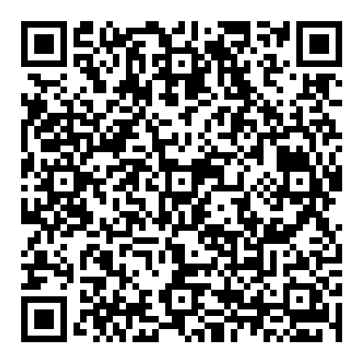
What “baby planets” look like audience segmentation
Which research aspects engage different audiences?
Technology and optics experts
Our early solar system and general audiences
Pitch to different news outlets based on their interests
More than just putting news on our website
Read story here:

Slide 8
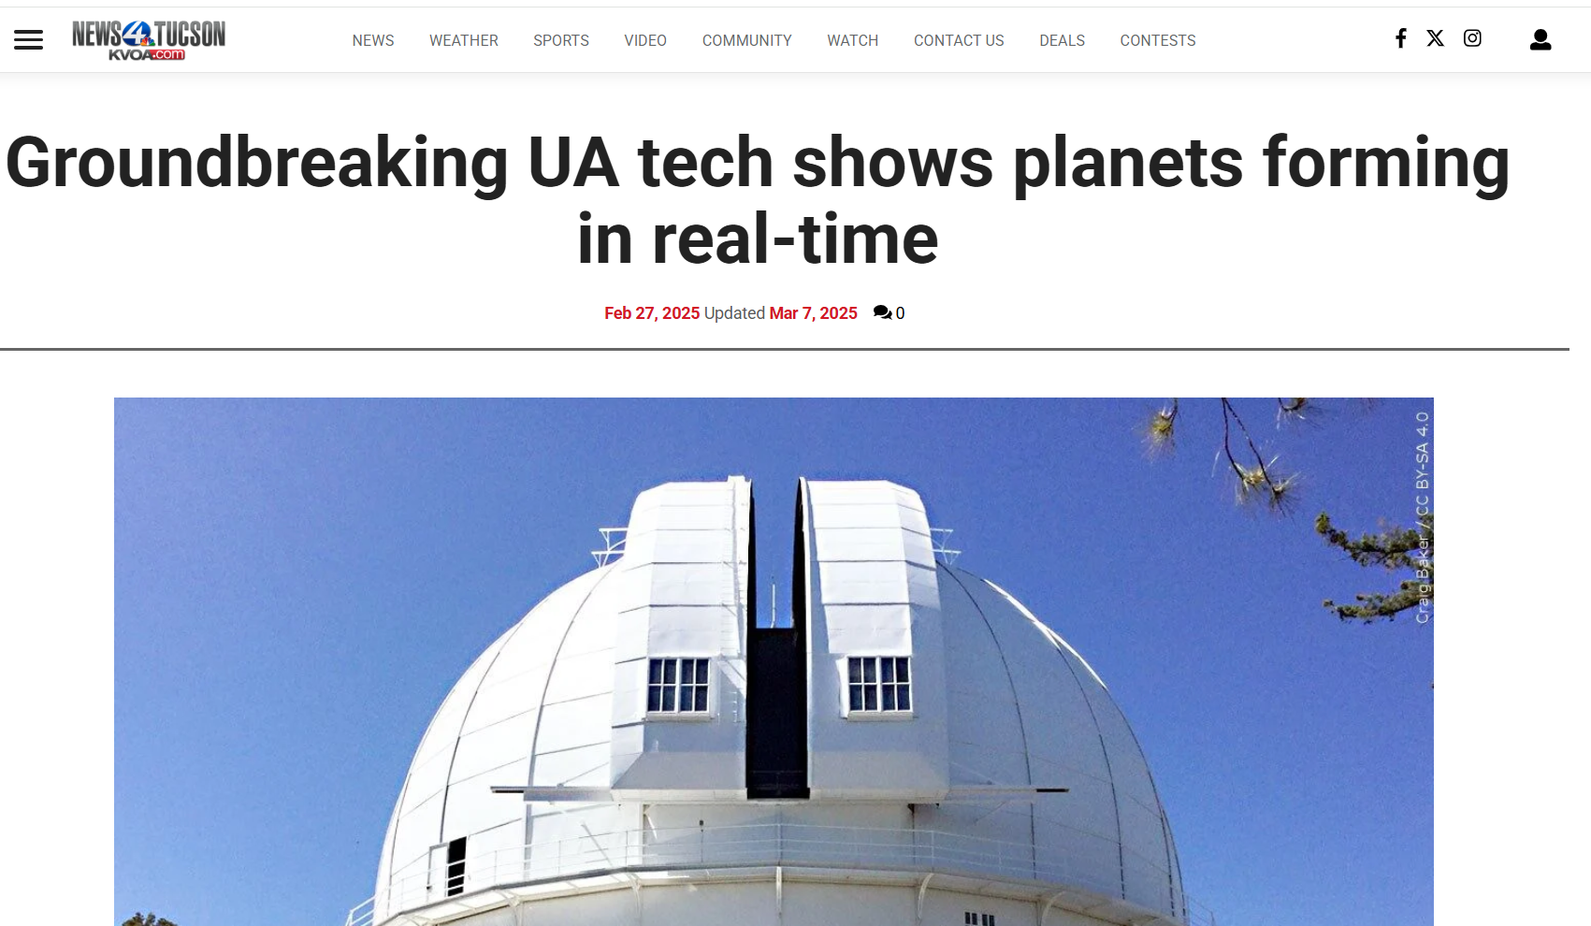
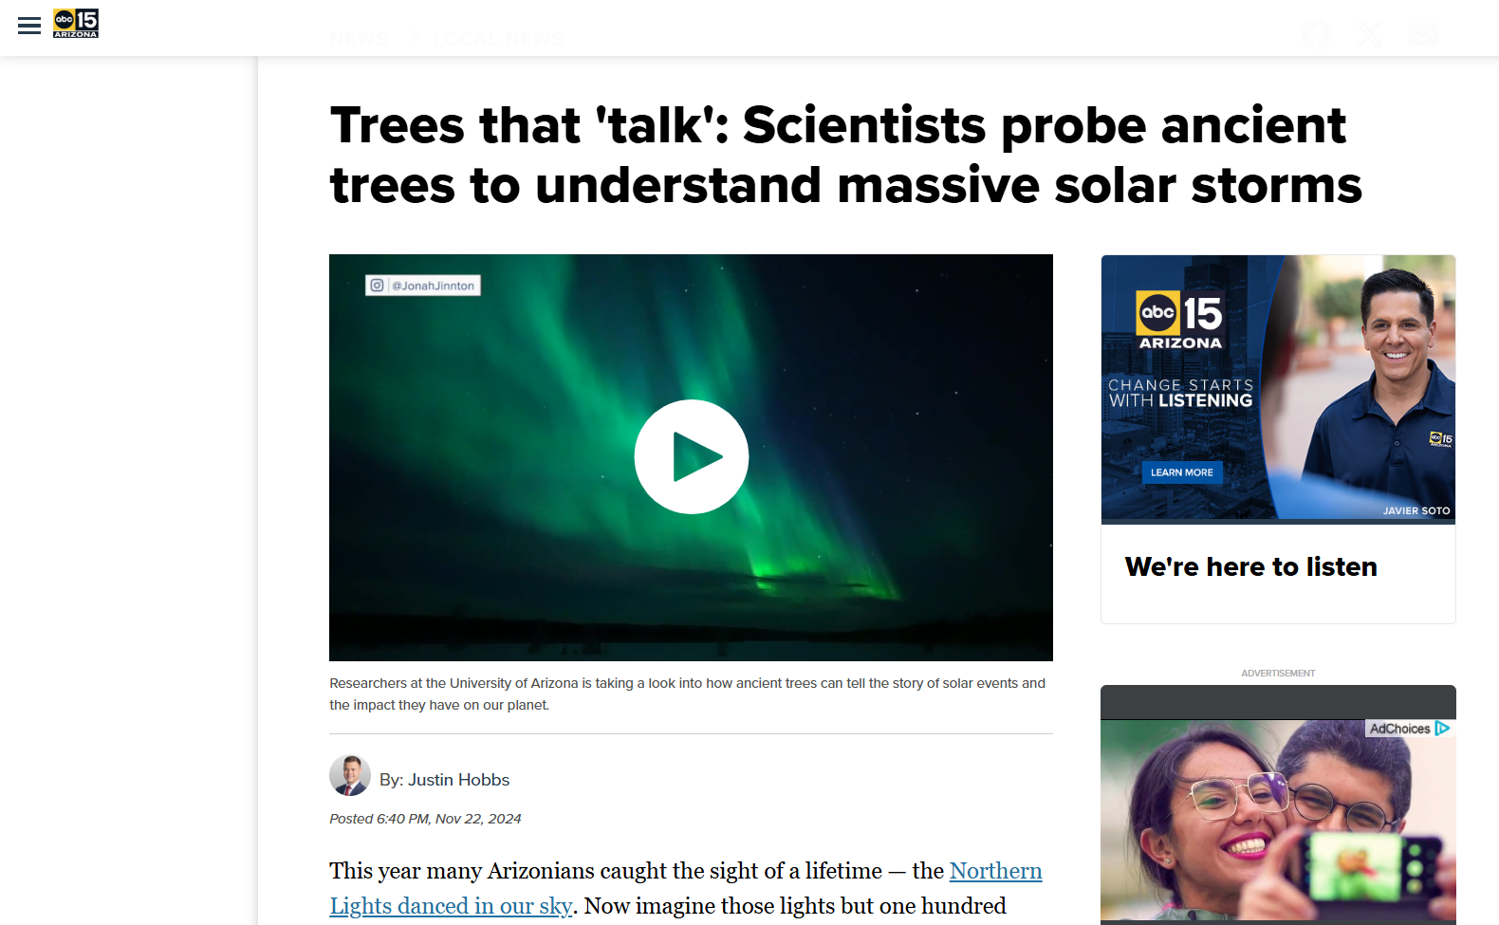
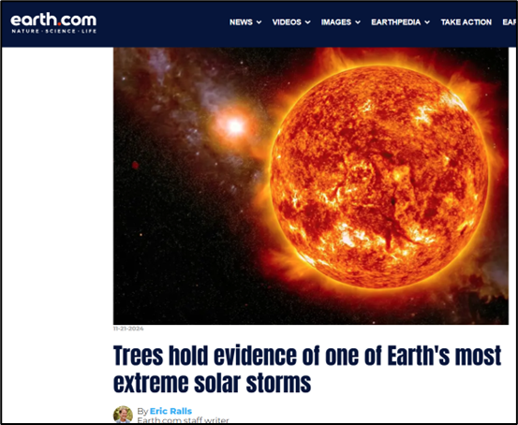
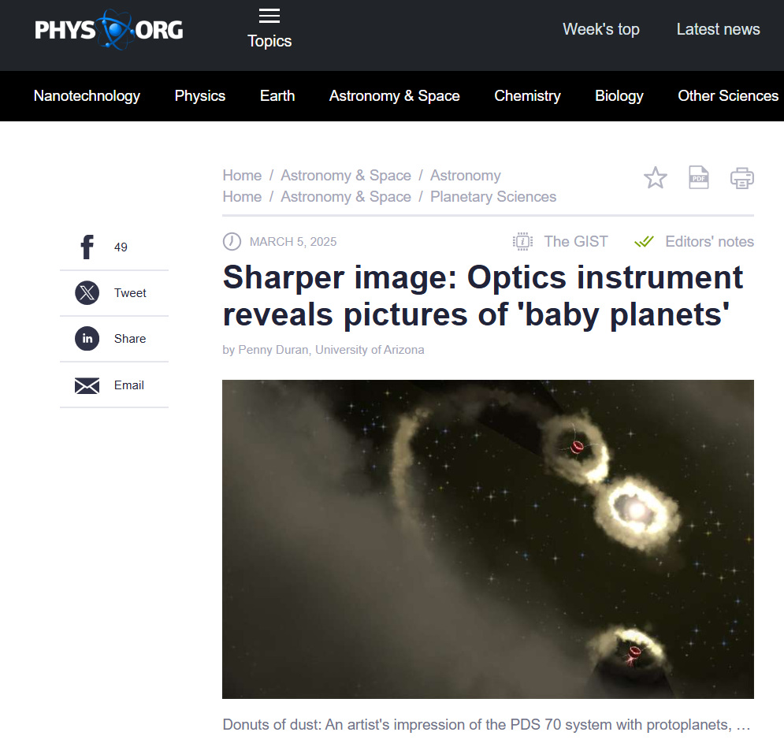
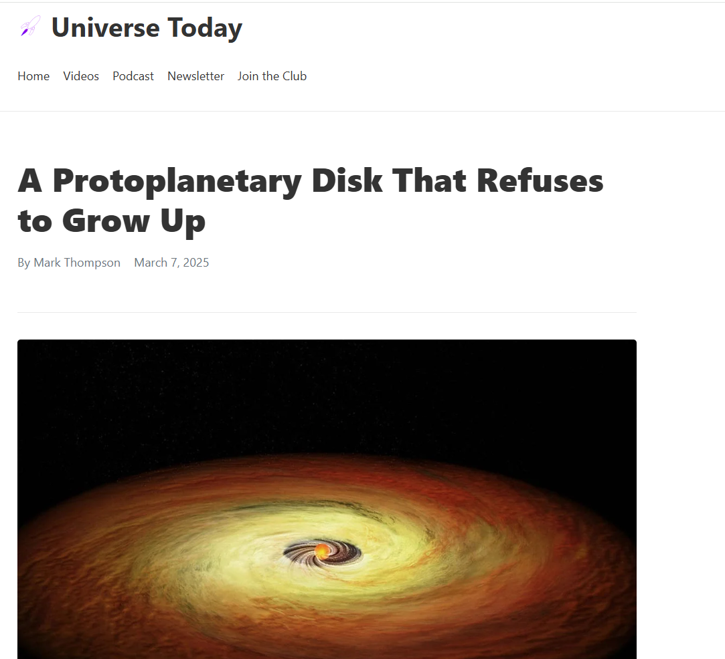
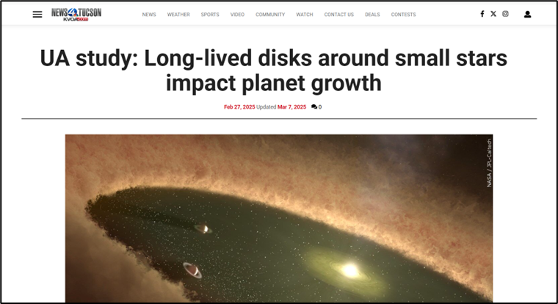
Media Coverage

Slide 9

Main takeaways
Science writing bridges gap between experts and general audiences
Perspective on research different from scientific journals
Increases reach of research, funding opportunities
Gives research a “human” element

Slide 10
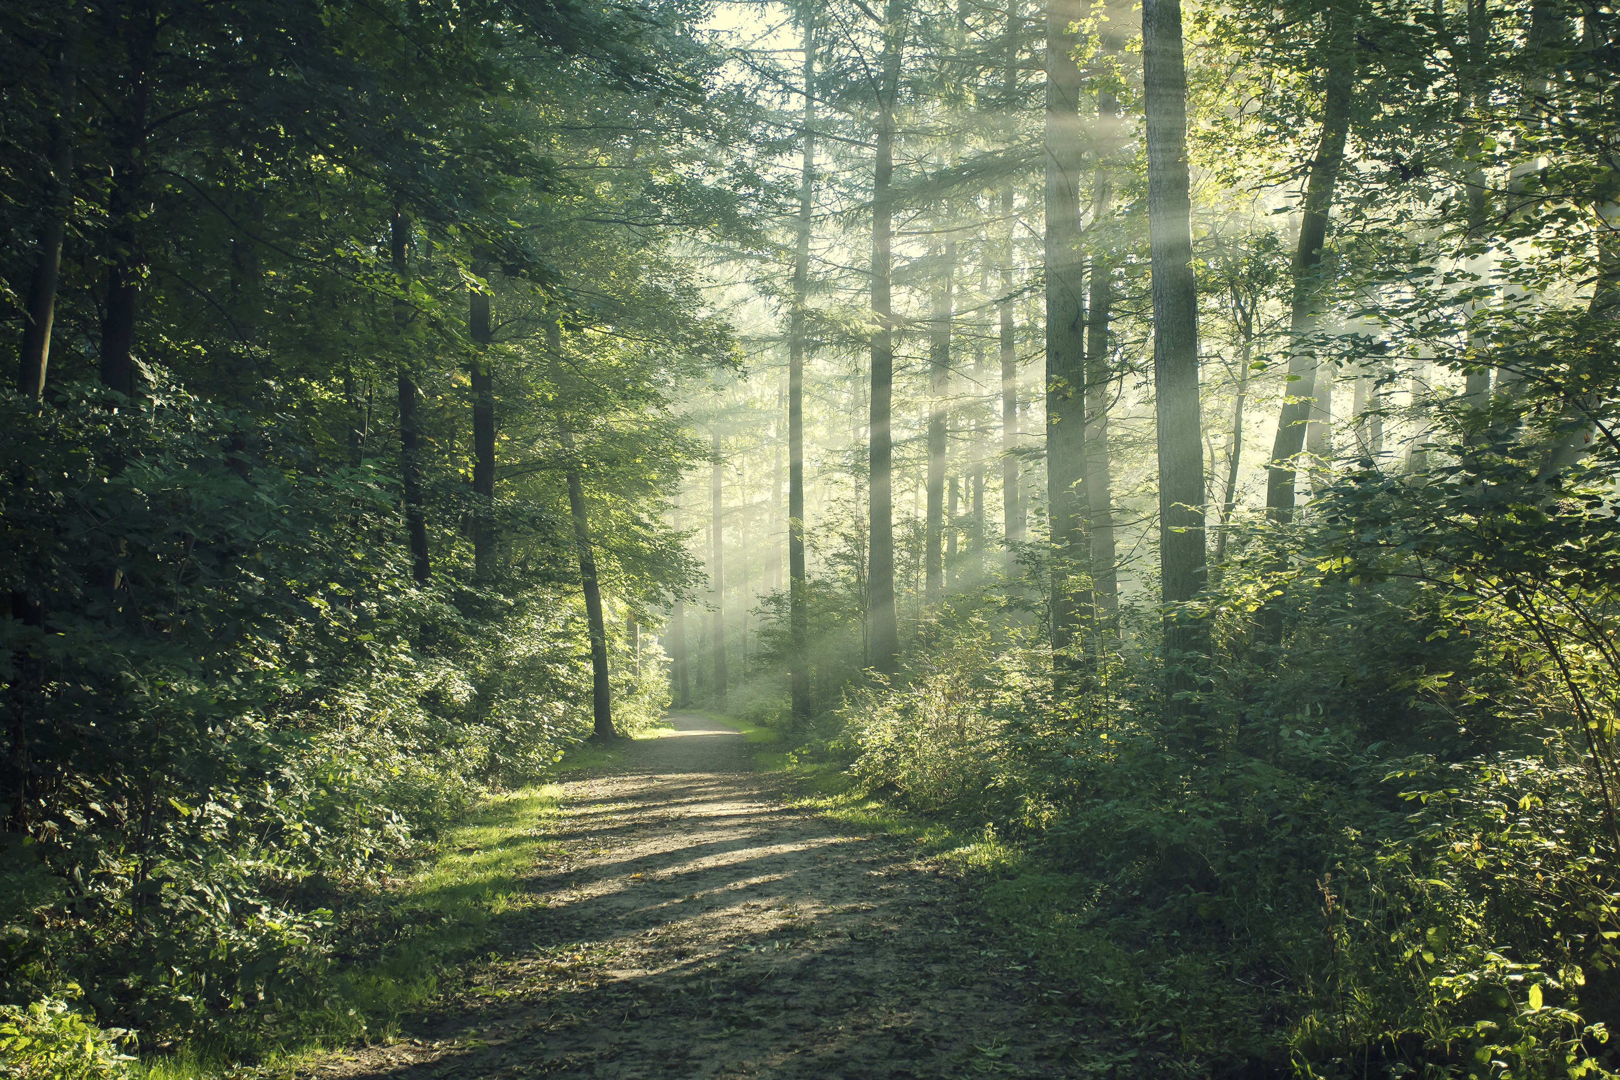
If a tree falls in a forest…
Or in other words… If research isn’t communicated, does it reach its full potential?

Slide 11



Acknowledgements
Daniel Stolte, University Communications
Dr. Michelle Coe
Dr. Chandra Holifield Collins
Arizona/ NASA Space Grant Consortium

Slide 12

Thank You!

